Slide 1


Towards Notification System for University Faculty Members and Students
Kingdom of Saudi Arabia
Ministry of Education
Jouf University
College of Computer and Information Sciences
PROJECT SUPERVISOR
Yasmeen Alomair
GROUP MEMBERS
Wejdan Othman Al-Belwi
Raghad Khaled Alshalan
Wafa Othman ALkhmis
2022/2023

Slide 2


Out Lines
01
02
03
04
08
ER DIAGRAM
09
DATA DICTIONARY
ABSTRACT
10
TECHNOLOGIES USED
PROBLEM STATEMENT
11
SYSTEM INTERFACES
PROJECT OBJECTIVES AND SCOPE
12
SYSTEM CODING
METHODOLOGY USED
13
SYSTEM TESTING
05
ANALYSIS DATA COLLECTION
(QUESTIONNAIRE)
16
CONCLUSION
06
FUNCTIONAL REQUIREMENTS
AND USE CASE DIAGRAM
17
REFERENCES
07
NON-FUNCTIONAL REQUIREMENTS
2

Slide 3
ABSTRACT
Different issues university students might face such as missed the deadline of add/drop courses, difficulty to communicate with faculty members, lack of background knowledge about courses, and absence due to change in the time/ room of lectures.
To solve these issues, we proposed to build a Notification System for University Students and Faculty Members.
The system should provide services like sending alert messages for students related to deadlines of important events, providing a description of courses, providing a communication method between students and faculty members, calculating the allowed absence percentage for each course and so on.
To examine the efficiency of the proposed system. It will be implemented in the context of Al-Jouf University.
3

Slide 4
PROBLEM STATEMENT
During the university study years, students might face several issues which can affect on his/her educational including
Missing deadline of enroll/ drop, selecting courses not aligned with their tends and abilities, and difficulties to communication with faculty member
Alteration in times/ rooms of lectures and no instant method to alert students/faculty members
The student might need a detailed illustration of his/her academic status
The student needs description about contents of the available courses prior to enroll in it and hence avoiding enrolling in inappropriate course
The faculty member needs to flexible scheduling method of his/her office hours to facilitate the communication with students
The student needs a resilient method to request meeting with the faculty member
The allowed absence percentage and deprivation policy are not clear for most students
4

Slide 5
PROJECT OBJECTIVES
The proposed system aims to achieve the following objectives:
To alert students about the important dates such as addition, deletion, apologize for course/ semester
To send an alert message for student and faculty members about the change of the course's time/ room.
To notify students about the allowed absence percentage for a course
To allow students to submit requests for their faculty member and explain the request's details.
To facilitate the communication between students and faculty members
To allow students choose an appointment to meet with faculty members online or offline
To allow faculty member schedule their students request and reply them
To allow the faculty member to schedule students meeting during office hours and show the available appointments for students to reserve it
To send a remind message for students one day before the final exam date
To allow students to know more about available courses via entering course code. This in turn help them to decide which courses are suitable for them
5

Slide 6
PROJECT SCOPE
The proposed idea targets universities as it is designed to serve university students and faculty members.
In this project we will build the system to serve students and faculty members in Al-Jouf University.
6

Slide 7
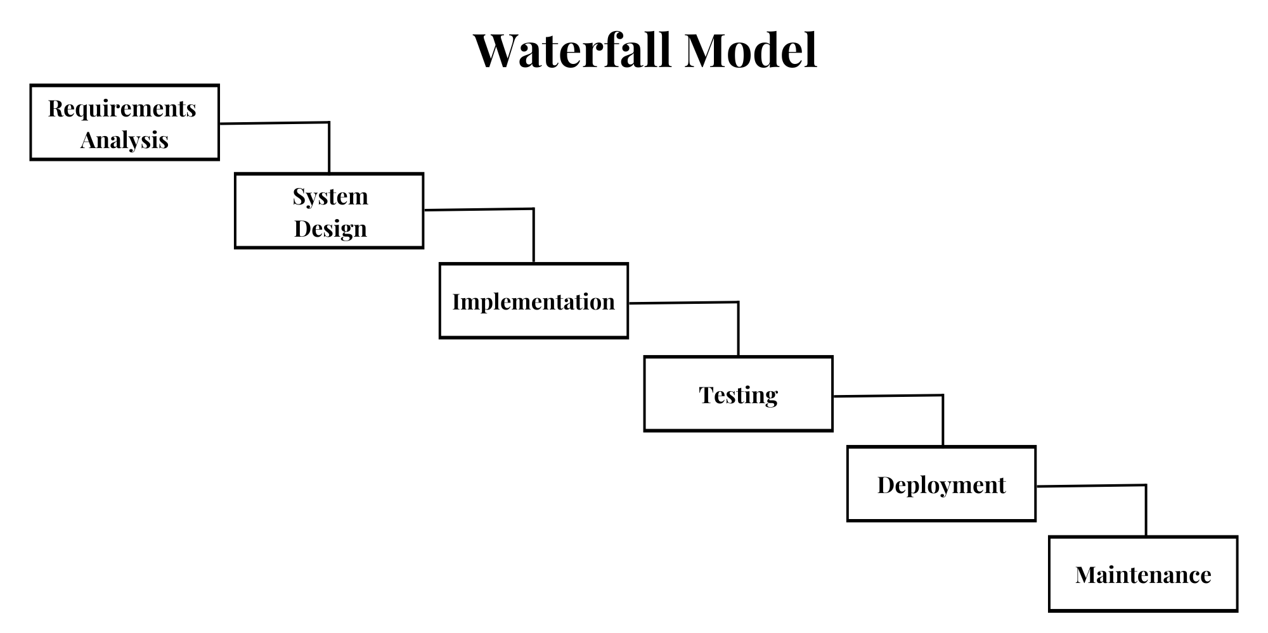
PROJTHE MODEL USED IN THE PROJECT
In this project, we will follow the waterfall model. As requirements are clear and it is suitable for the project implementation in terms of complexity, ease, and safety.
This model represents the design of the system and the phases that we must follow to design a system, and it composed of several phases, each phase is no less important than the other, and each phase relies on the phase that precedes.
The requirements are clear and easy to realize. For smaller projects, the waterfall model works well and leads to the appropriate findings.
(Waterfall Model)
7

Slide 8
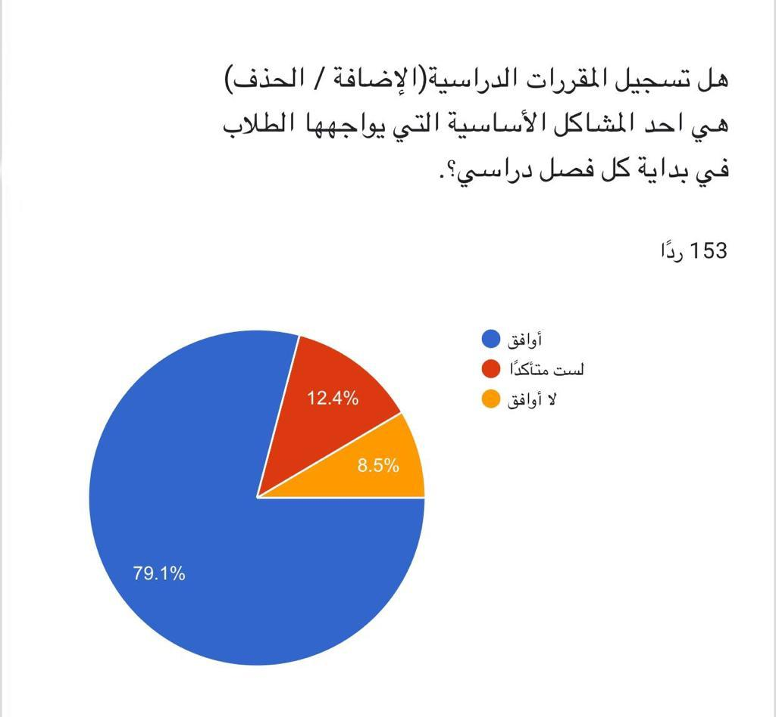
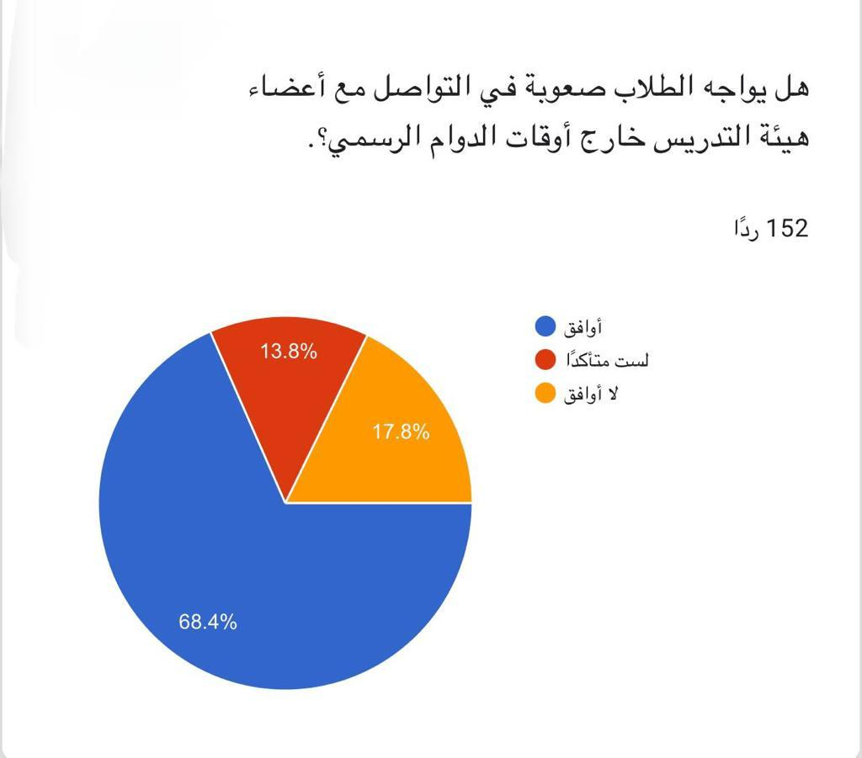
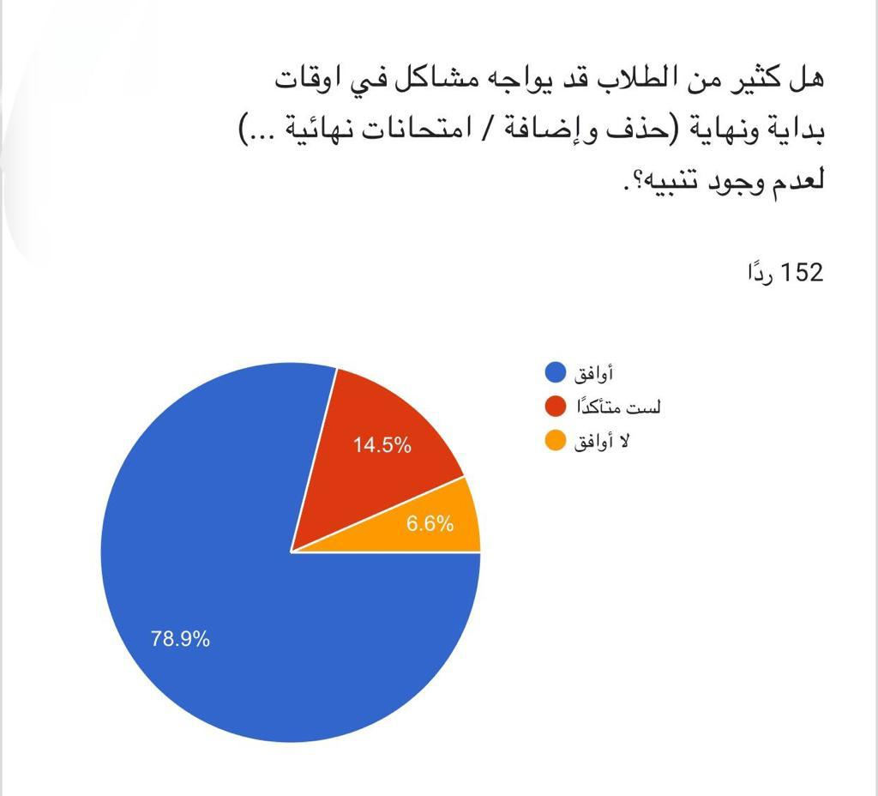
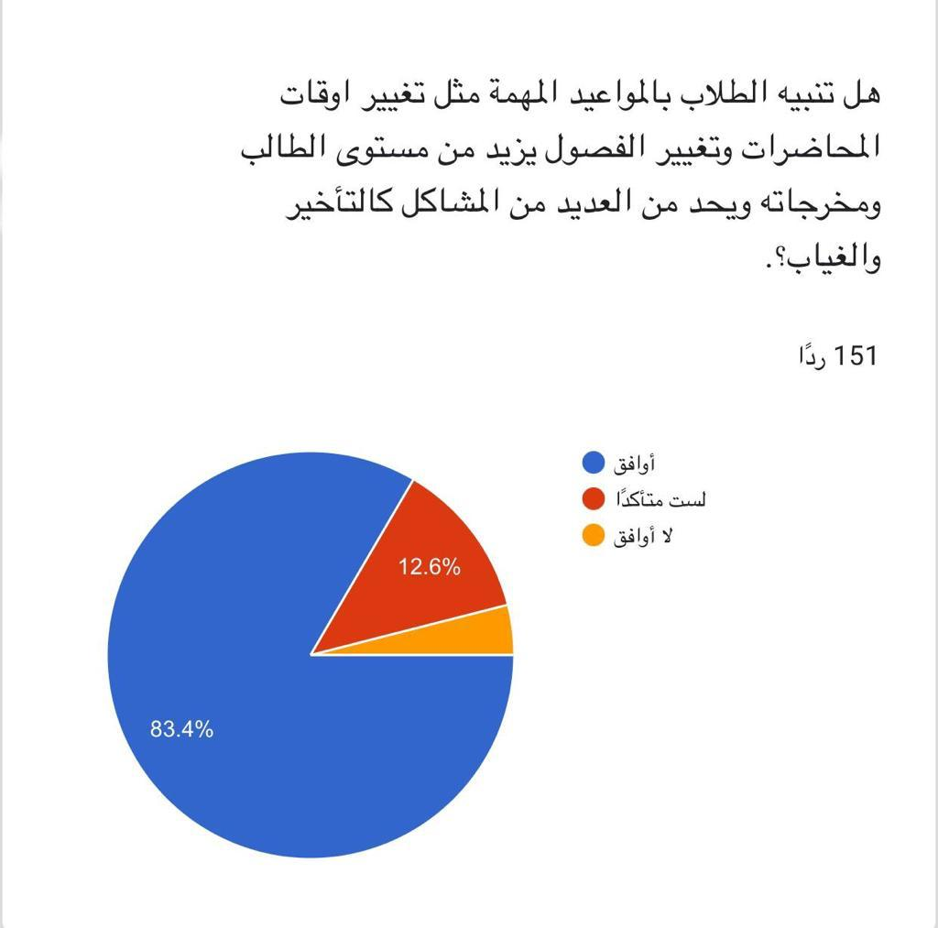
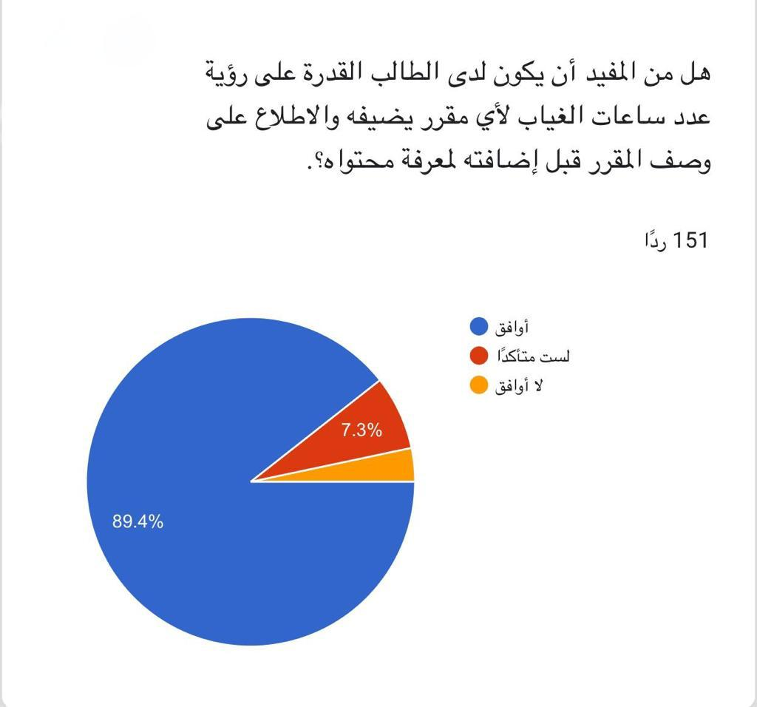
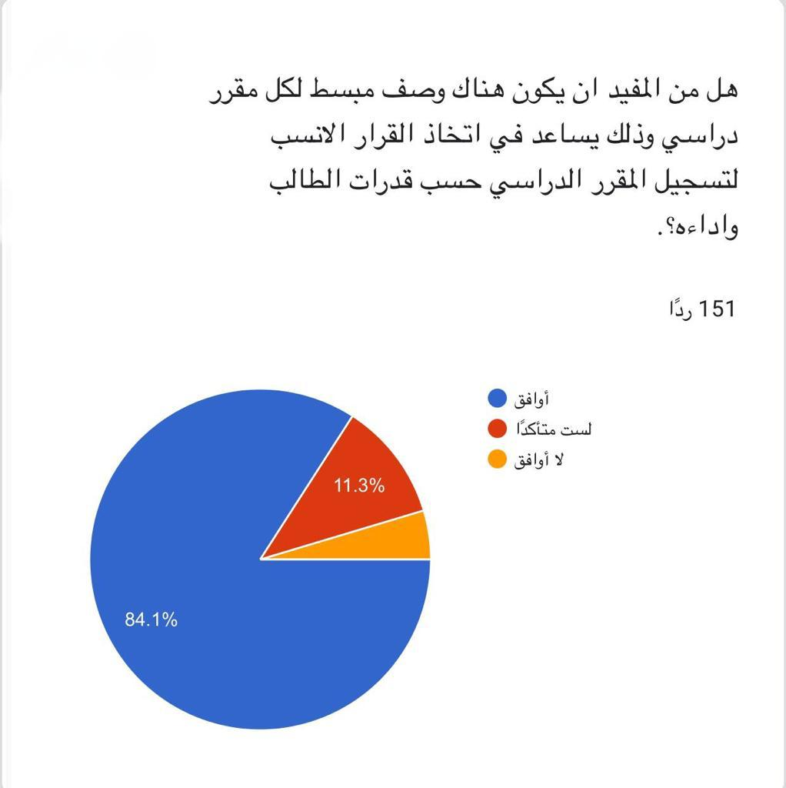
ANALYSIS DATA COLLECTION (Questionnaire)
8

Slide 9
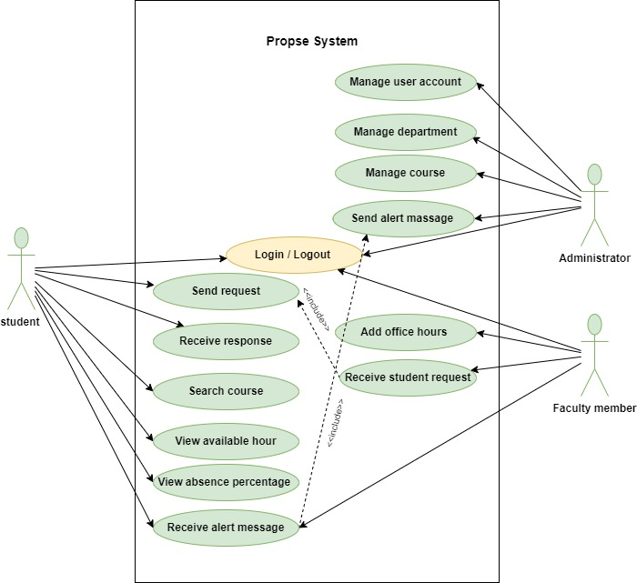
REQUIREMENTS ANALYSIS FUNCTIONAL REQUIREMENTS
Actors Identification
System administrator
Faculty member
Student
9

Slide 10
NON-FUNCTIONAL REQUIREMENT
Reliability
Availability
Security
Stability
Performance
Maintenance
Response Time
Usability
10

Slide 11
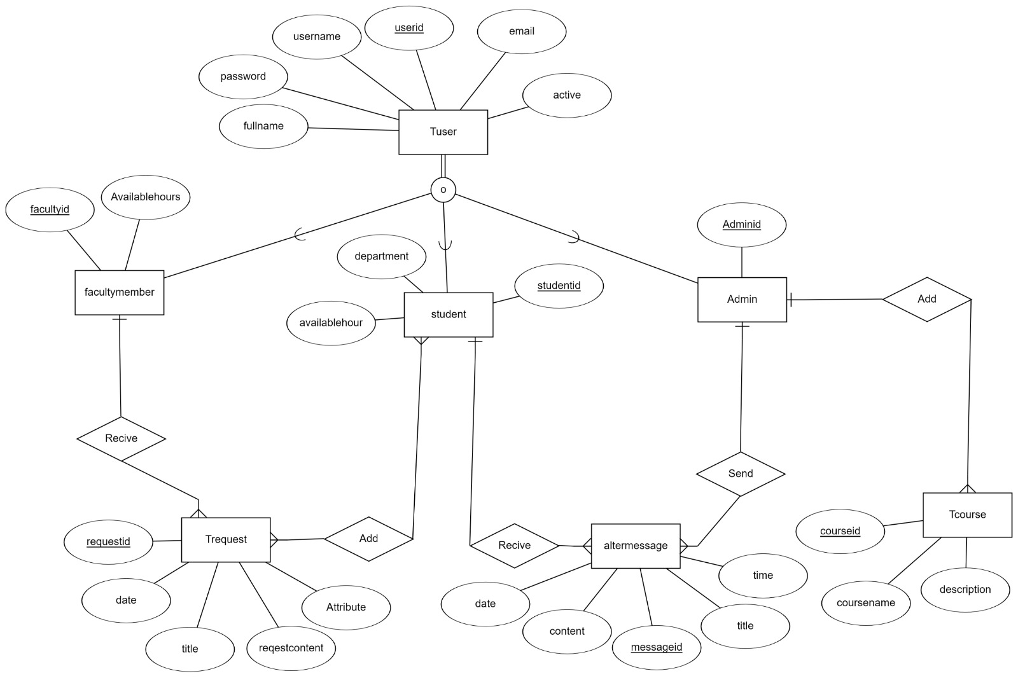
ENTITY RELATIONSHIP DIAGRAM
11

Slide 12
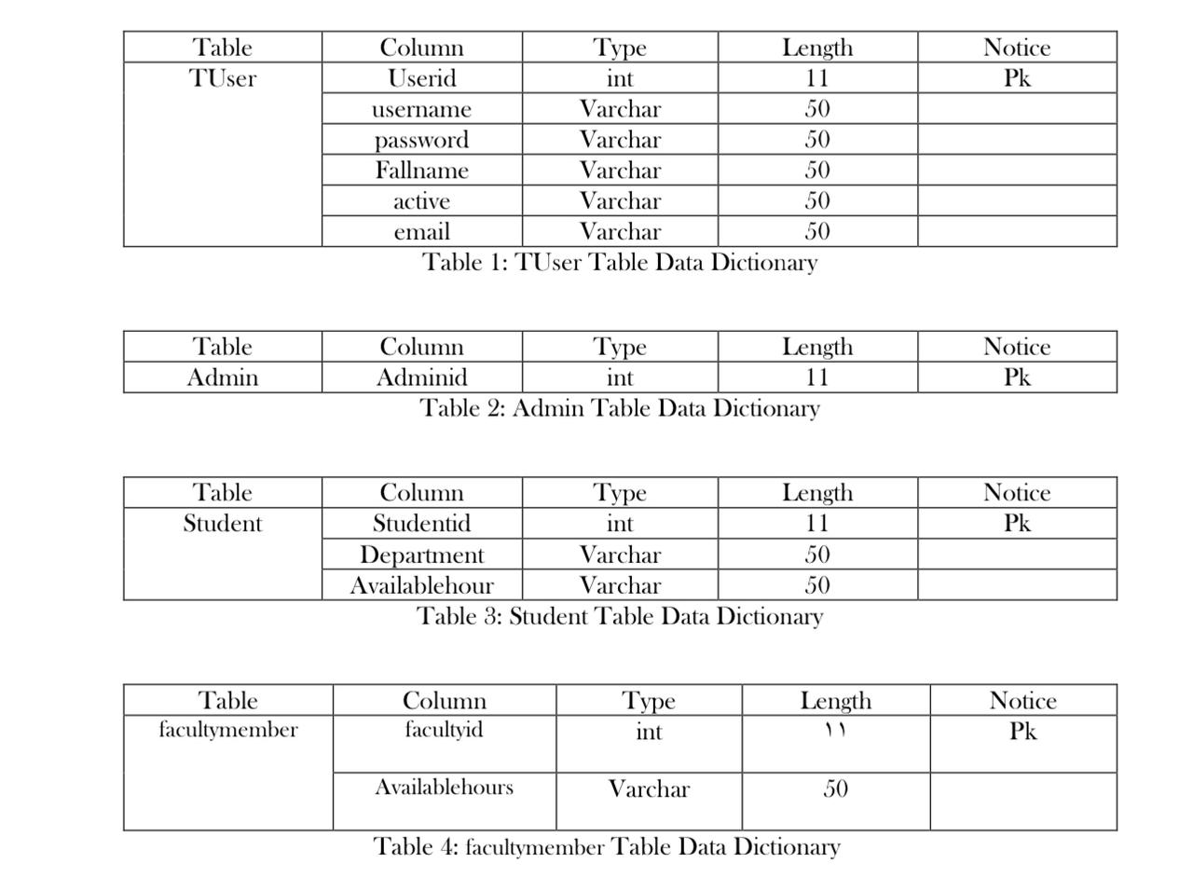
DATA DICTIONARY
12

Slide 13
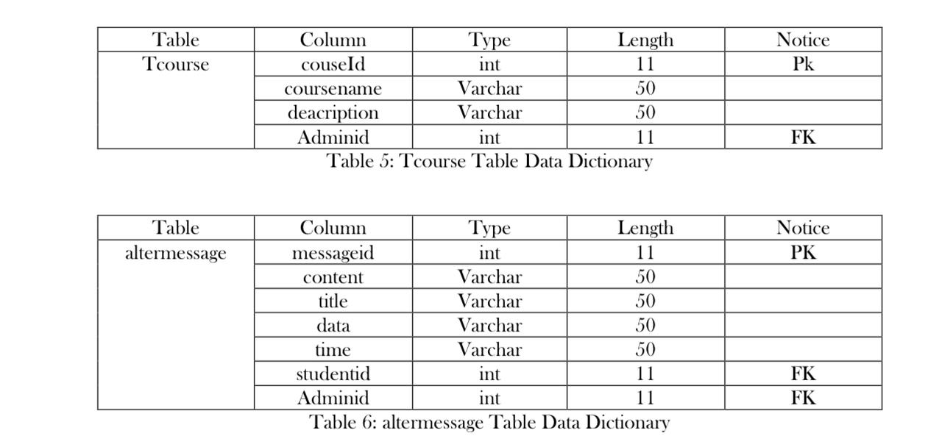
DATA DICTIONARY
13

Slide 14
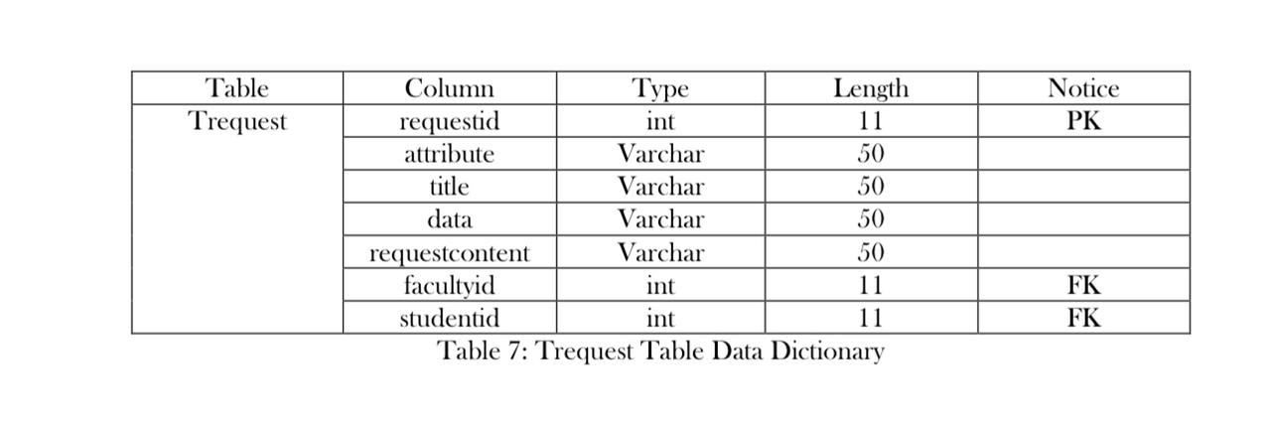
DATA DICTIONARY
14

Slide 15
TECHNOLOGIES USED
XAMPP Used to run database with My SQL.
Android studio Android Studio is the official Integrated Development Environment (IDE) for Android app development.
Android Studio is a new and fully integrated development environment, which has been recently launched by Google for the Android operating system. It has been designed to provide new tools for app development .
15

Slide 16
TECHNOLOGIES USED
Java
Java mobile application development has long been on the rise since Java is a versatile and powerful programming language that enables developers to create robust, high-performing applications.
For mobile app development language, Java has many benefits and reasons to stick to it.
XML
We used xml to design the interfaces of the mobile app.
16

Slide 17
TECHNOLOGIES USED
Why Java and XML for Android?
JAVA Used for coding. This page control all the elements of xml with time. You can give default attributes values for different elements in xml, which will be used (for that particular element) in Activity(app) until you change that attribute in corresponding JAVA file for that particular element.
SQL Structured query language (SQL) is a programming language for storing and processing information in a relational database. A relational database stores information in tabular form, with rows and columns representing different data attributes and the various relationships between the data value
17

Slide 18
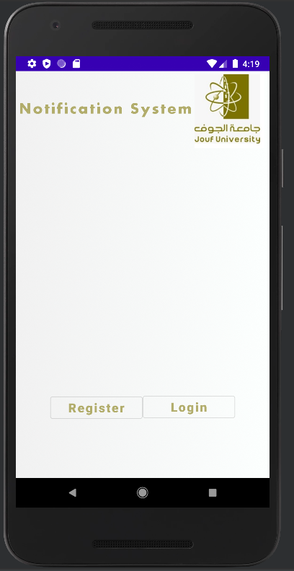
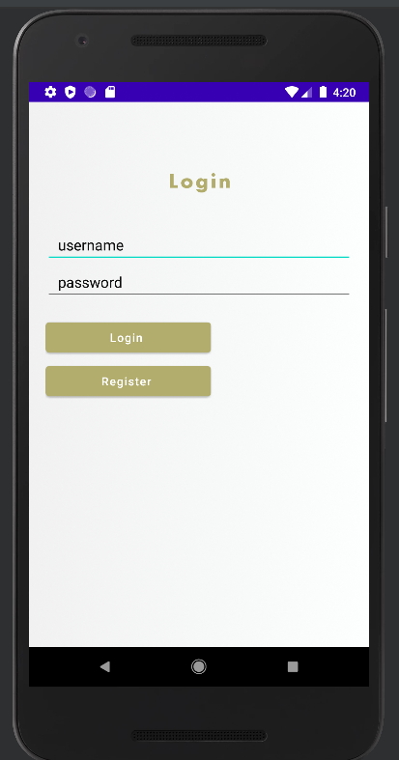
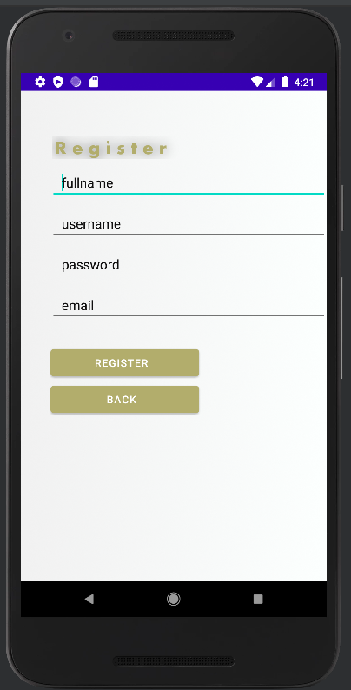
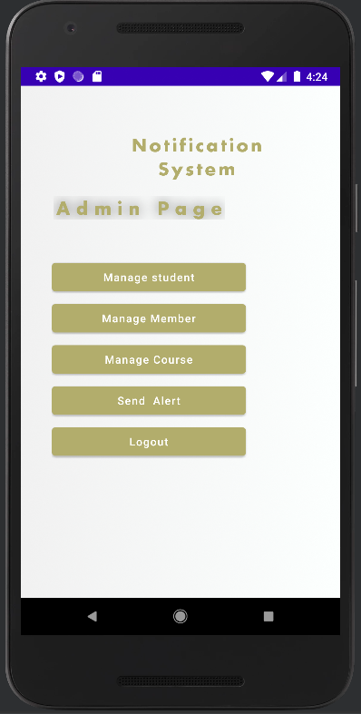
SYSTEM INTERFACES
Homepage Interface Login Interface Register Interface Admin Interface
18

Slide 19
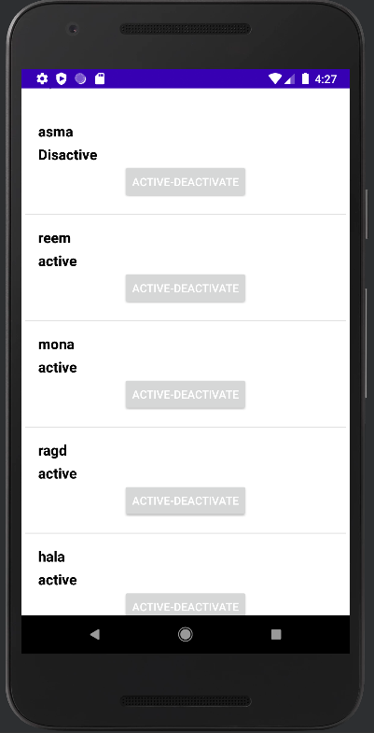
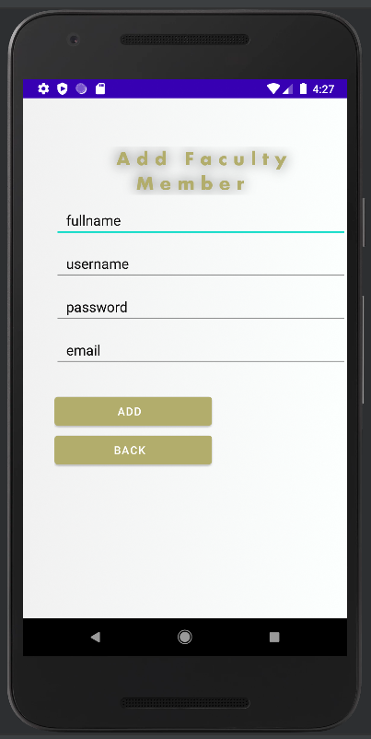
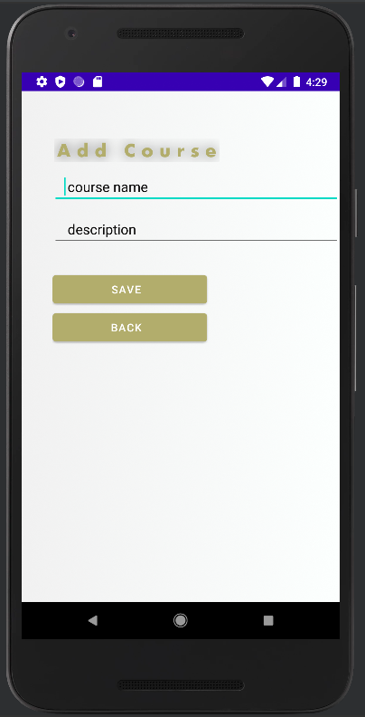
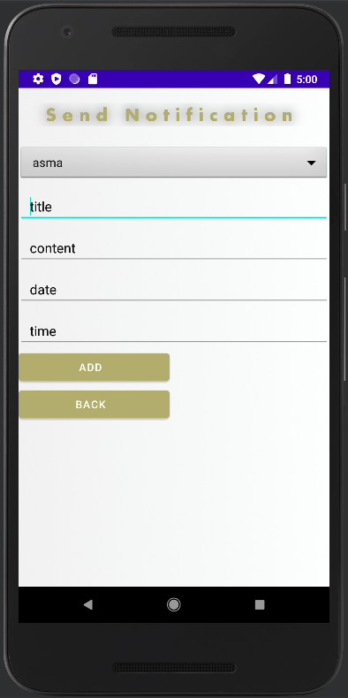
SYSTEM INTERFACES
Admin [ Manage Student Interface ]
Admin [ Manage Faculty Member Interface ]
Admin [ Add Course Interface ]
Admin [ Send Alert Interface ]
19

Slide 20
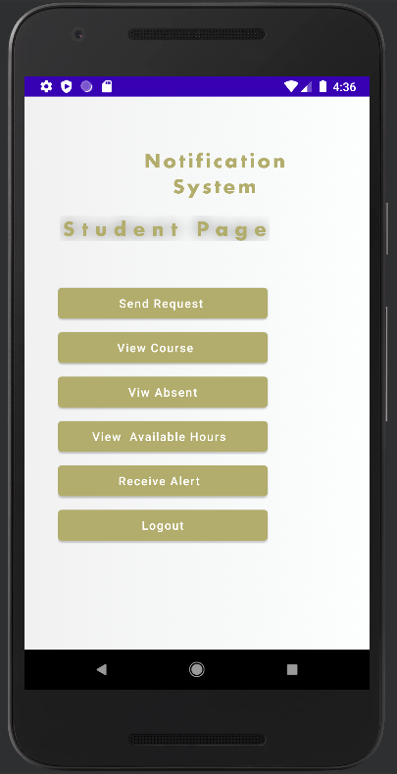
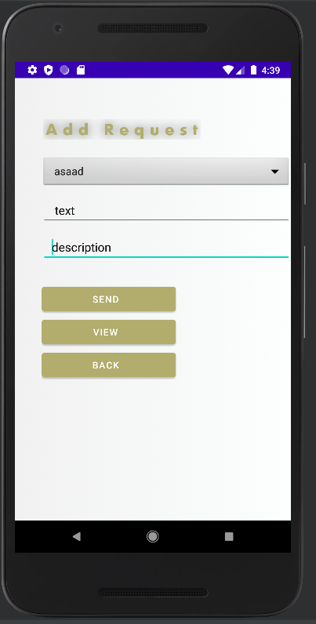
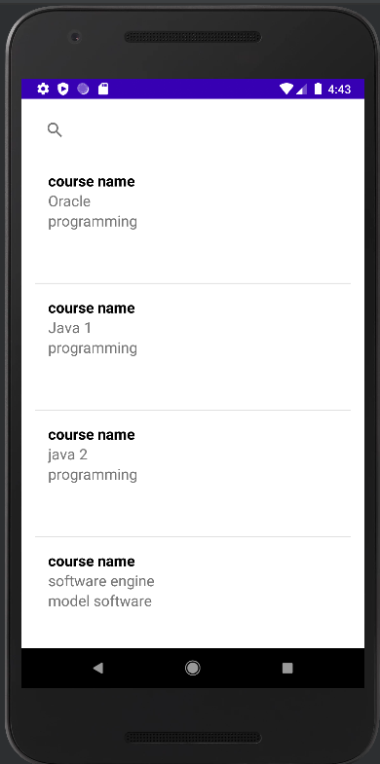
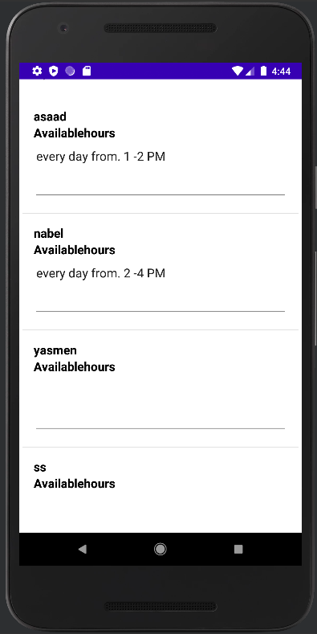
SYSTEM INTERFACES
Student Interface
Student [ Send Request Interface ]
Student [ Search Courses Interface ]
Student [ View Available Hours Interface ]
20

Slide 21
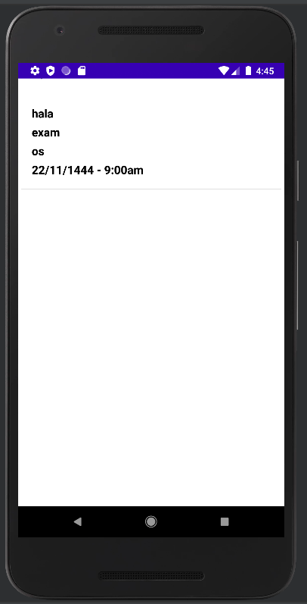
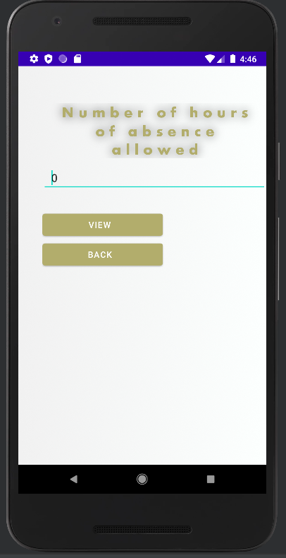
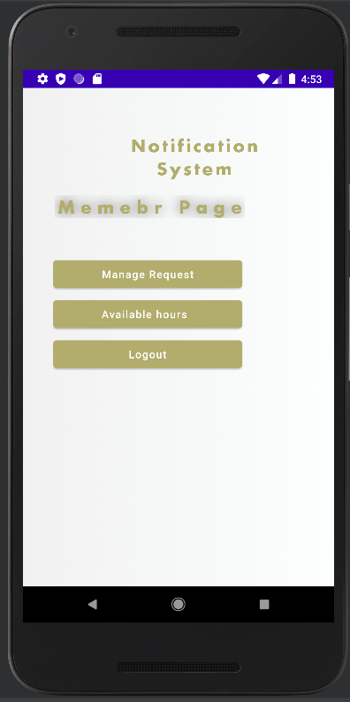
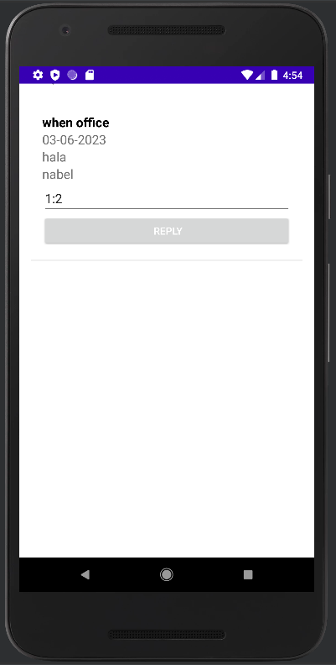
SYSTEM INTERFACES
Student [ Receive Alert Interface ]
Student [ View Absent Hours Interface ]
Faculty Member Interface
Faculty Member [ Reply Request Interface ]
21

Slide 22
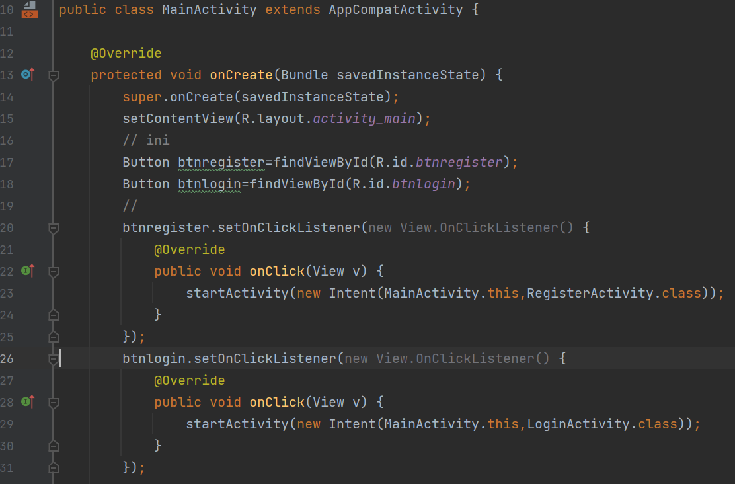
SYSTEM CODING
Homepage Code
22

Slide 23
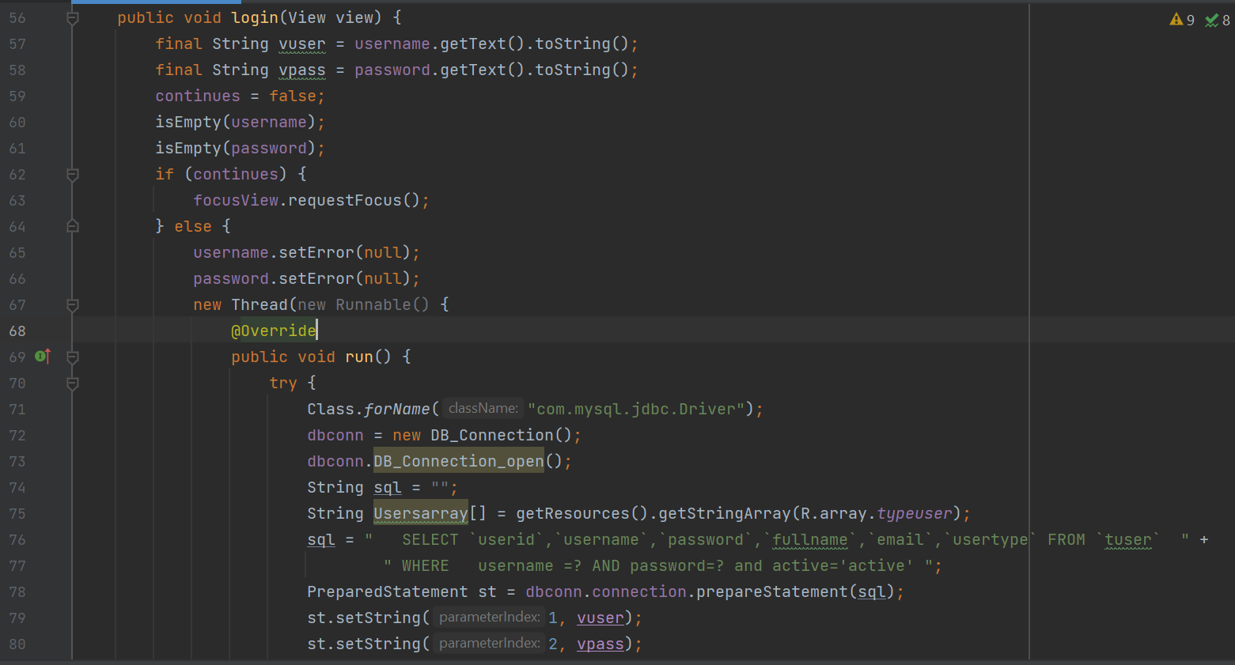
SYSTEM CODING
Login Code
23

Slide 24
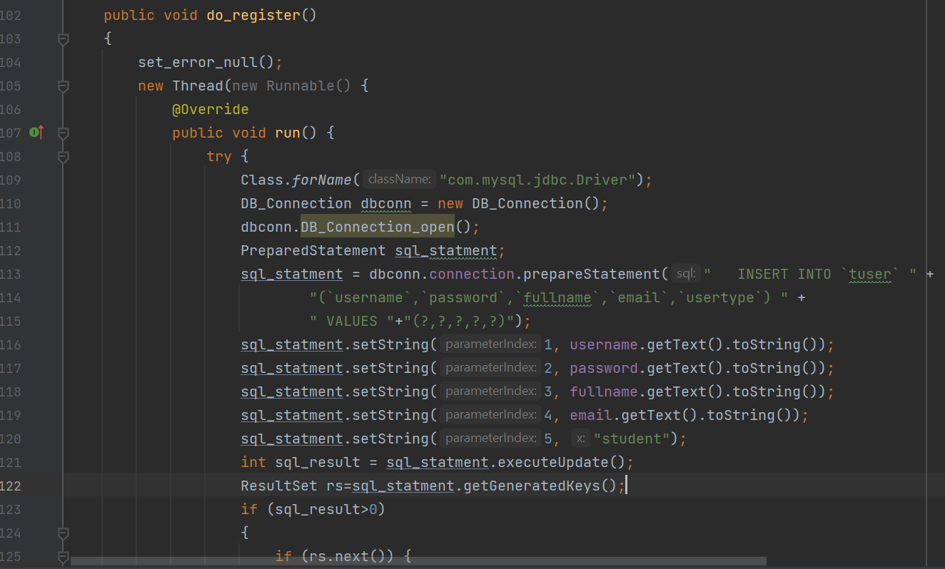
SYSTEM CODING
Register Code
24

Slide 25
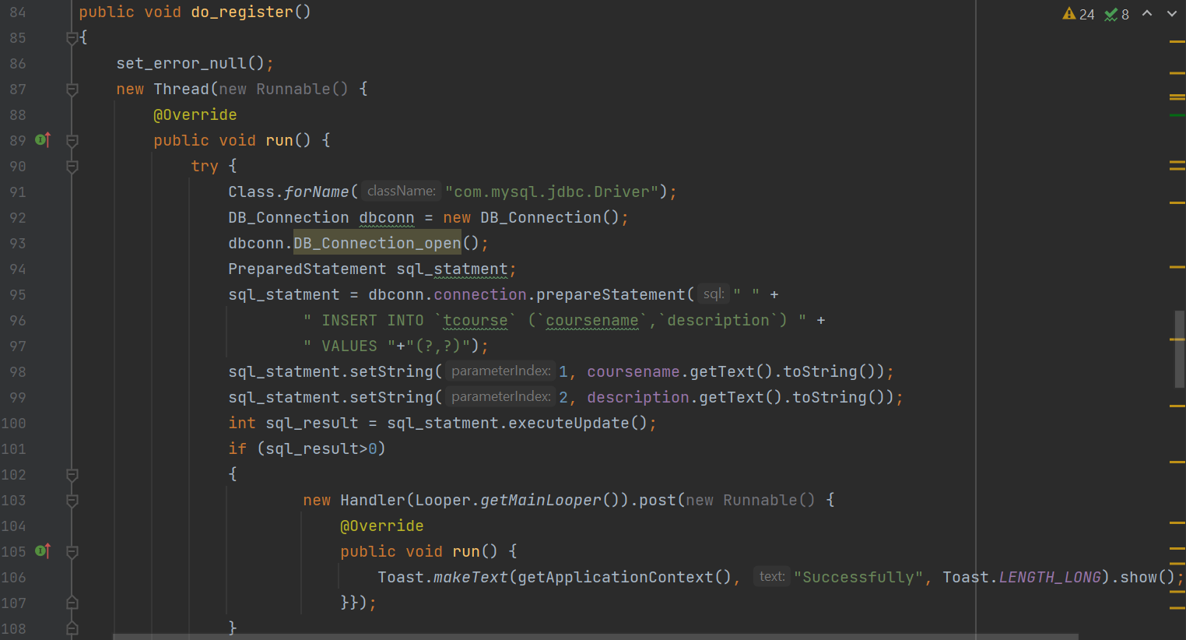
SYSTEM CODING
Add Course Code
25

Slide 26
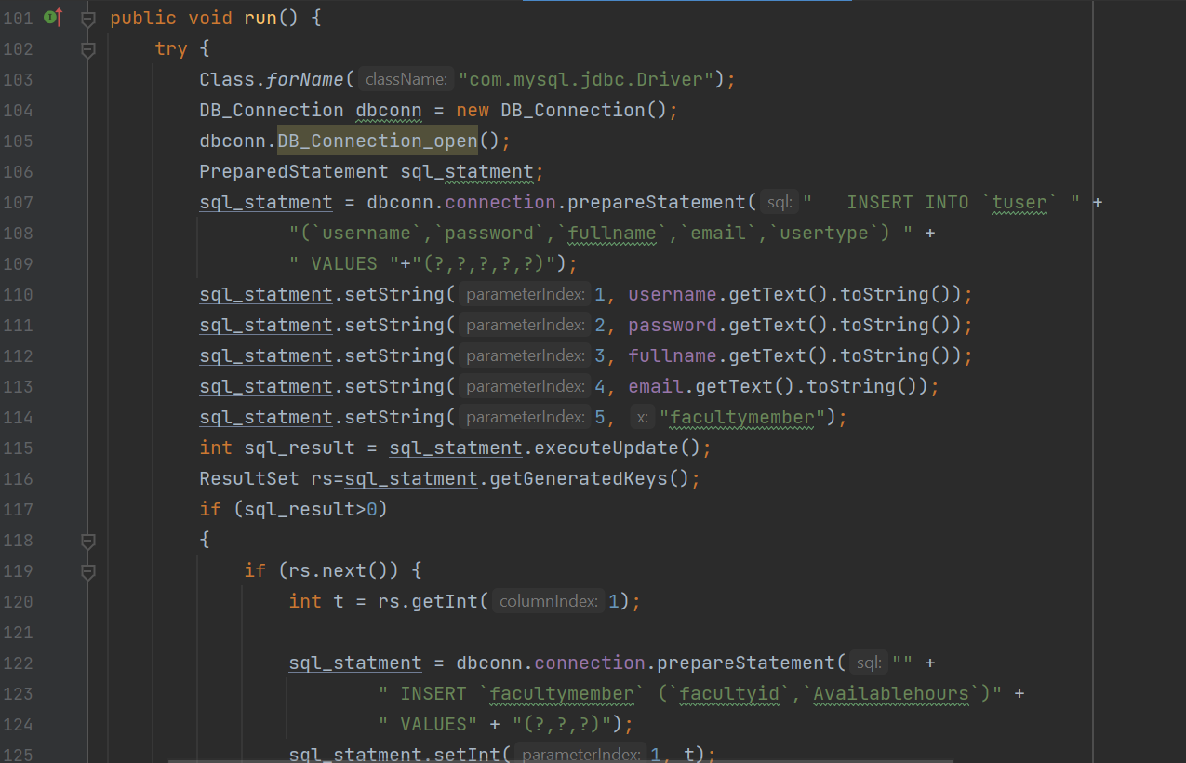
SYSTEM CODING
Add Faculty Member Code
26

Slide 27
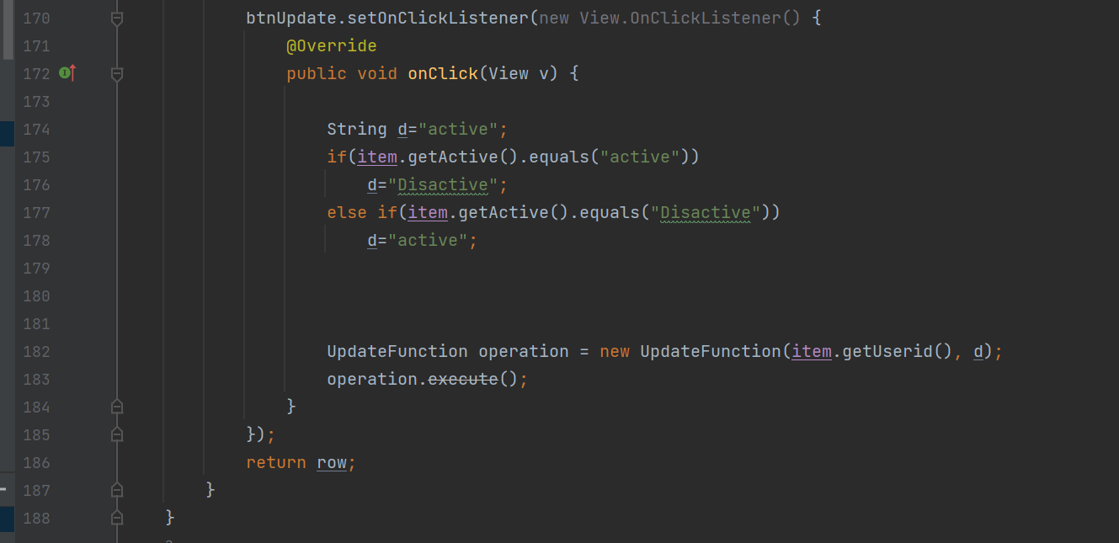
SYSTEM CODING
Admin Active or Disactive Student Code
27

Slide 28
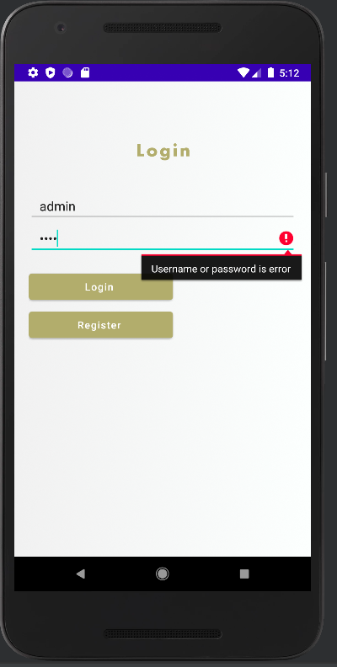
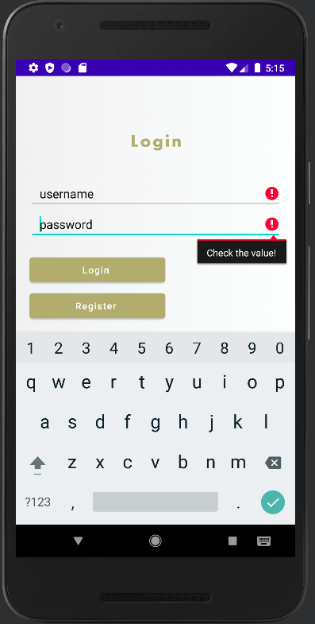
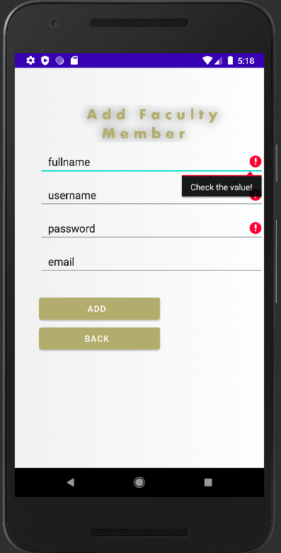
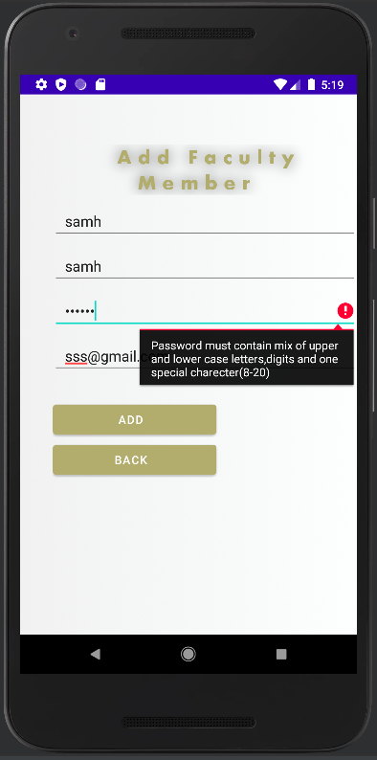
SYSTEM TESTING
Invalid Login Empty Input Any Empty Input Invalid Password
28

Slide 29
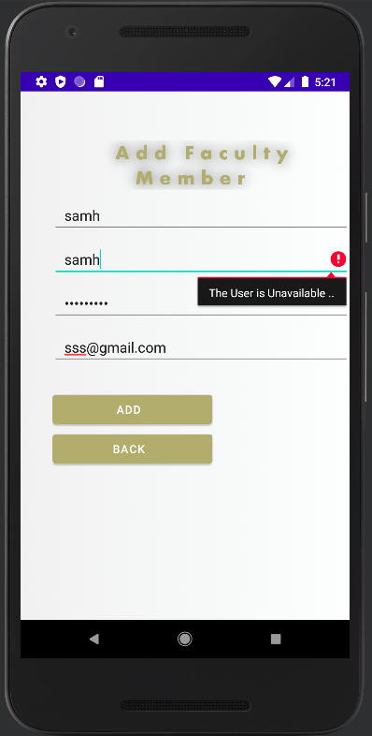
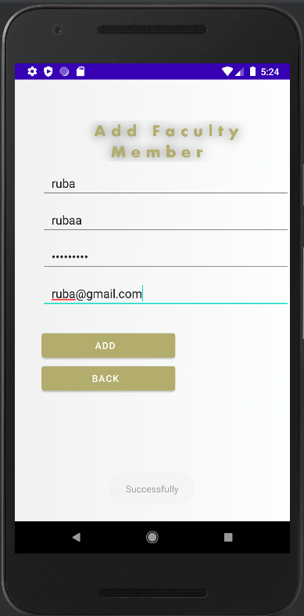
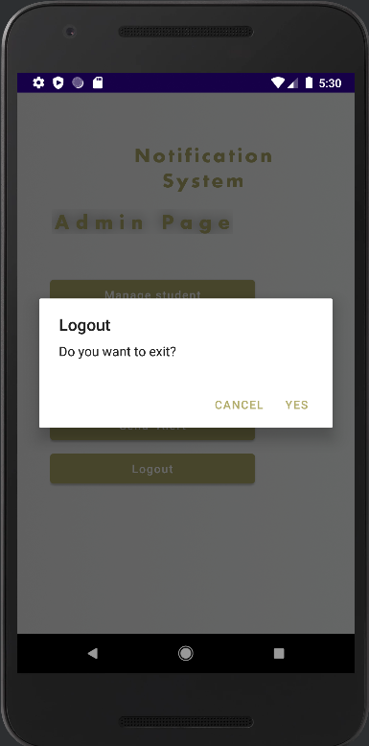
SYSTEM TESTING
Duplicate Username
Valid Add for Faculty Member
A Dialog to Confirm That You Are Logged Out
29

Slide 30
CONCLUSION
We have completed this document, in which we showed the stages of project development, which is a notification system for university students and faculty members. We provide some UML diagrams like use case diagram, class diagram, sequence diagrams, ER diagram,, and database dictionaries. In addition, we implement this project to make it a real system, also we made the test phase to know if the system meets the user's requirements or not. The application facilitates the process of learning of the students through the system, which aims to solve the issues that might the students via providing several services like sending alert messages for students related to deadlines of important events, providing a description of courses, providing a communication method between students and faculty members, calculating the allowed absence percentage for each course and so on.
30

Slide 31
REFERENCES
[1]H. Koç, A. M. Erdoğan, Y. Barjakly, and S. Peker, “UML Diagrams in Software Engineering Research: A Systematic Literature Review,” Proceedings, vol. 74, no. 1, Art. no. 1, 2021, doi: 10.3390/proceedings2021074013.
[2]F. Ciccozzi, I. Malavolta, and B. Selic, “Execution of UML models: a systematic review of research and practice,” Softw Syst Model, vol. 18, no. 3, pp. 2313–2360, Jun. 2019, doi: 10.1007/s10270-018-0675-4.
[3]S. Al-Fedaghi, “Conceptual Data Modeling: Entity-Relationship Models as Thinging Machines.” Sep. 29, 2021. doi: 10.22937/IJCSNS.2021.21.9.33.
[4]S. Al-Fedaghi, “Diagramming the Class Diagram: Toward a Unified Modeling Methodology.” arXiv, Sep. 30, 2017. doi: 10.48550/arXiv.1710.00202.
[5]G. Guthrie, “What is an architecture diagram, and why do you need one? - Learn Wordpress,” Nulab, 2021. https://nulab.com/learn/software-development/what-is-an-architecture-diagram-and-why-do-you-need-one/ (accessed Feb. 09, 2023).
31

Slide 32
Thank You
Any Questions?
32

